Slide 1
Market Making

Slide 2
Agenda
Attendance
Brain Teasers
Project Introduction
Intro to Python (Might be skipped)
Begin project

Slide 3
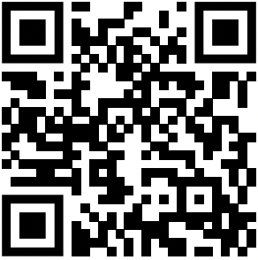
Attendance Form

Slide 4
Brain Teaser
Two people are playing a game with a circular table. Each turn a player places a quarter on the table. The coin must not overlap any coins. Once a player can not make a move they lose the game. Write a winning strategy for the first player to guarantee they win the game.

Slide 5
Brain Teaser
Given a number n create an algorithm to count how many sets of consecutive positive integers add up to that number n.
Ex: (6) -> {6}, {1,2,3}
Ex: (15) -> {15}, {7,8}, {4,5,6}, {1,2,3,4,5}

Slide 6
Brain Teaser - Prisoner Hats
One hundred prisoners are each randomly assigned a hat that is either red or blue. They stand in a single file line where each person can only see the hat of the people in front of them. Starting from the back they each say one word “red” or “blue”. If the color matches their hat they are set free. Find a strategy that the prisoners can use to guarantee the highest amount get set free.

Slide 7
Brain Teaser - Tigers and Sheep
Let’s say we have 100 Tigers and 1 Sheep on an island. The Tigers want to eat sheep. If a tiger eats a sheep it turns into a sheep. Each tiger prioritizes its life first and then eating a sheep. What happens?

Slide 8
Project Introduction - Market Making Simulator
We will be building an simulator for a dice related market making game.
We will have cpu players
User players
Ways to simulate dice rolls

Slide 9
Example CPU Player Strategies
CPU that lags behind the actual dice rolls (1 turn behind)
CPU that knows the next roll before it happens
CPU that underestimates the market
CPU that overestimates the market
CPU that properly assesses the market
CPU that rigs a dice roll

Slide 10
Intro to Python
https://www.kaggle.com/learn/python

Slide 11
Begin Working on the Project

